Slide 1
Rockbuster STEALTH
Management Questions for 2020 Company Strategy

Slide 2
Business Strategy Questions
● What was the average rental duration for all videos?
● Which movies contributed the most/least to revenue gain?
● Where are customers with a high lifetime value based?
● Which countries are Rockbuster customers based in?
● Do sales figures vary between geographic regions?
Objective: Develop insights to help with the launch strategy for the new online video service.

Slide 3









Where we stand
Movies
Release Year
Language
1000
2006
English
Average
Rental Duration
Average
Rental Rate
Average
Run Time
While management was most
interested in looking at our average rental
duration, we felt it would be pertinent to start by
reviewing that plus a few additional data points
regarding our current selections and customer base
5 Days
$2.98
115 Minutes
Customers
Countries
Stores
599
109
2

Slide 4
What’s Working and What Isn’t
Reviewing contributions to total revenue by film, genre and rating

Slide 5
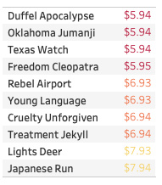
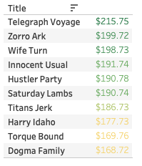
Top Movies and bottom Movies by revenue generated

Slide 6
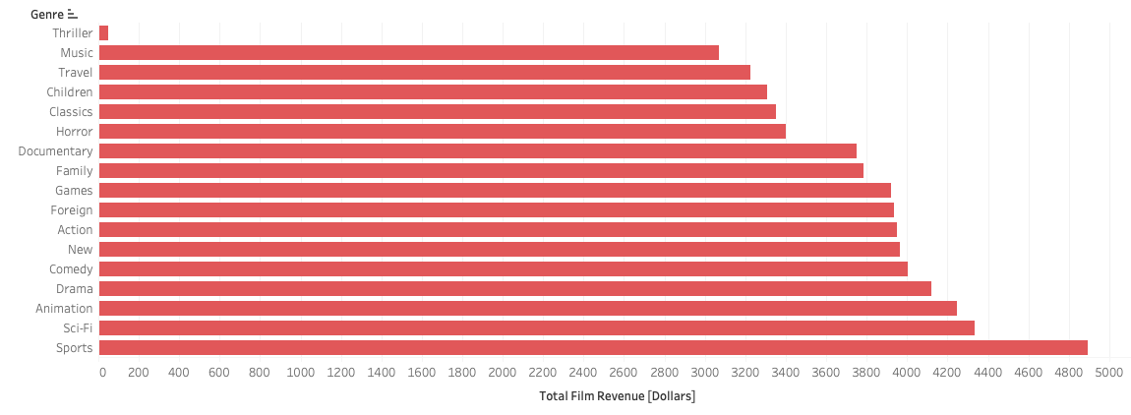
Total Revenue Generated for each genre in the catalog

Slide 7
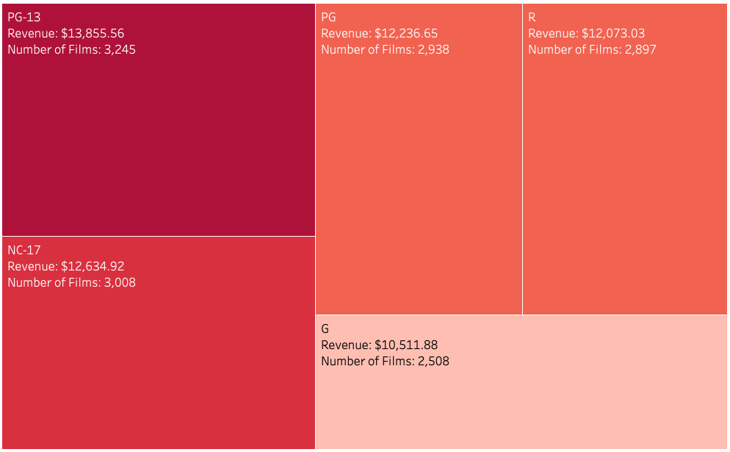
Total Revenue Generated for each Rating in the catalog

Slide 8
Do any genres or ratings produce more revenue per film?
Genre (top 5) | Revenue per Film
Comedy | $ 4.70
New | $ 4.59
Sports | $ 4.53
Games | $ 4.44
Horror | $ 4.40
Rating | Revenue per Film
PG-13 | $ 4.27
NC-17 | $ 4.20
G | $ 4.19
R | $ 4.17
PG | $ 4.16
The bottom 5 genres are all below $4

Slide 9
Examining our footprint
Top customers and top countries in the Rockbuster footprint

Slide 10
Rockbuster top customers
Customer | Country | Total Spent
Eleanor Hunt | Runion | $211.55
Karl Seal | United States | $208.58
Marion Snyder | Brazil | $194.61
Rhonda Kennedy | Netherlands | $191.62
Clara Shaw | Belarus | $189.60
No clear geographic grouping

Slide 11
Rockbuster top Countries
Country | Total Spent | Customer Count | % of Total Revenue
India | $6,034.78 | 1422 | 9.84%
China | $5,251.03 | 1297 | 8.56%
United States | $3,685.31 | 869 | 6.01%
Japan | $3,122.51 | 749 | 5.09%
Mexico | $2,984.82 | 718 | 4.87%
Top 5 countries account for over 1/3 of revenue

Slide 12
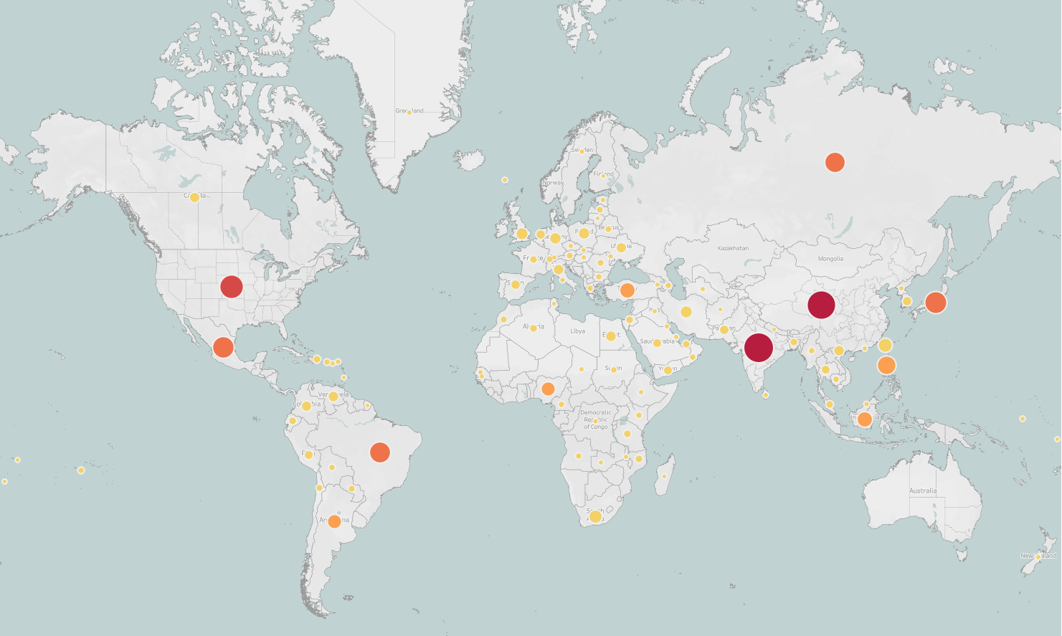
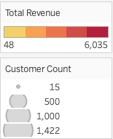
Notes:
To view an interactive version of this map visit the following link:
https://public.tableau.com/app/profile/adam.busenbark/viz/RockbusterMap/Sheet6?publish=yes

Slide 13
INSIGHTS AND RECOMMENDATIONS
Rockbuster’s top two countries by total revenue and number of customers accounts for nearly 20% of all Rockbuster revenue. The business intelligence department recommends starting the streaming service by piloting in these two countries
Rockbuster’s top customers are not concentrated in any specific geographic region, marketing the service to high value customers without regard to region would not be effective at this time
There is not a high degree of variability for how much money a film generates based on it’s rating, however, certain genres do produce more revenue per film. Focusing on these higher generating genres could be beneficial at the start.

Slide 14
Thank you
Source materials, Tableau link and data dictionary available upon request from the business intelligence department

